Slide 1
Microsoft AI Tour

Slide 2
Copilot Ready: Security, Data, and Security

Slide 3
Agenda
Welcome & Framing (15 min)
Discover OverSharing Risks (10min)
Secure Copilot Agents (15 min)
Secure Interaction Data (15 min)
Governance Planning (10 min)
AI Security Assessment (5 min)
Wrap-Up (5 min)

Slide 4
Secure and govern Microsoft 365 Copilot + Agents
Address oversharing concerns
Protect against data loss and insider risks
Govern AI use to meet regulations & policies
Gain visibility into overshared content
Remediate excessive permissions
Prevent Copilot + Agents from processing sensitive files
Get alerts and reports of risky behavior and AI use
Protect sensitive files and interactions
Dynamically apply security policies based on risky actions
Inspect interaction content and audit logs
Investigate for compliance and ethical violations
Enforce lifecycle policies and legal holds

Slide 5

Microsoft 365 Copilot is built on trust
Microsoft commitments and controls
Tools to manage Copilot + agents

Slide 6




Copilot Control System
Copilot + Agents
Security & Governance
Management Controls
Measurement & Reporting
Data security
AI security
Compliance & privacy
Copilot licensing
Agent lifecycle
Customization
Readiness and adoption
Productivity impact
Business value & ROI

Slide 7
Top security and governance concerns about generative AI
Data oversharing and data leaks
Identification of risky AI use
AI governance and risk visibility
80%
41%
84%
of leaders cited leakage of sensitive data as their main concern¹
of security leaders cited that the identification of risky users based on queries into AI was one of the top AI controls they want to implement²
Want to feel more confident about managing and discovering data input into AI apps and tools²
First Annual Generative AI study: Business Rewards vs. Security Risks, Q3 2023, ISMG, N=400
Microsoft data security index 2024 report

Slide 8
How Copilot gets access to content
Copilot retrieves only the information you have access to
Orchestration Process
1
2
3
4
5
You submit a prompt
Orchestrator determines what it needs to answer the prompt
Orchestrator uses Graph to find relevant info you are allowed to access
Orchestrator appends info to your prompt to enhance it
LLM uses additional that information to generate a response

Slide 9

A complete solution for enterprise-ready AI
Secure
Govern
Honors your existing permissions
Supports your lifecycle policies and audit requirements
Copilot + Agents
Protects against data loss and insider risk
Detect and investigation non-compliant and unethical usage
Microsoft Purview
Assess oversharing risks and apply recommended corrections
Guided assistance to remain compliant with AI regulations

Slide 10
Discover Oversharing
with Purview DSPM for AI and SharePoint Advanced Management

Slide 11
Tools to secure and govern your Copilot use
Address oversharing concerns
Protect against data loss and insider risks
Govern AI use to meet regulations & policies
Gain visibility into overshared content
Remediate excessive permissions
Prevent Copilot + Agents from processing sensitive files
Get alerts and reports of risky behavior and AI use
Protect sensitive files and interactions
Dynamically apply security policies based on risky actions
Inspect interaction content and audit logs
Investigate for compliance and ethical violations
Enforce lifecycle policies and legal holds
Secure
Govern

Slide 12
Prepare data for Copilot + Agents by ensuring correct access to files
What is oversharing?
Copilot + Agents only access data that an individual user is authorized to access
Oversharing happens when an employee has access to information beyond what is necessary to do their job
What causes oversharing?
Accidentally saving a file to a location with broad access permissions
A user sharing content with someone who should not have access
Files do not have access protections

Slide 13
Remediate excessive permissions and apply oversharing protections
Prepare
Operate
Fix existing oversharing risks
Monitor for new oversharing risks
Restrict user and/or Copilot + Agent access to risky sites while remediating identified oversharing risks
Act on policy suggestions to mitigate oversharing risks
Prevent Copilot + Agents from processing certain sensitive files and from using them in responses if required
Remove organization-wide site access as needed
Get notifications when new oversharing occurs with options for remediation
Further secure sensitive data through file level access controls and Data Loss Prevention policies
Improve Copilot+ Agent responses by archiving or deleting unneeded content
For detailed guidance see: aka.ms/Copilot/OversharingBlueprintLearn

Slide 14
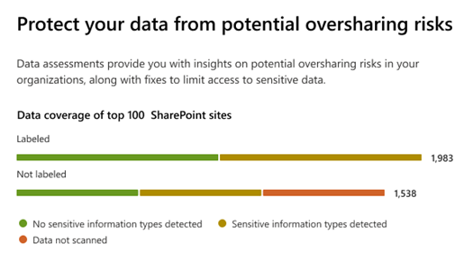
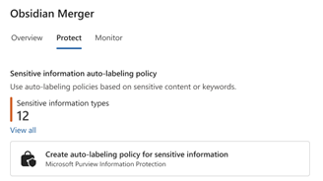
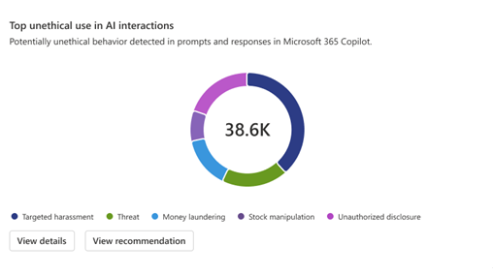
Identify and mitigate risks related to AI usage
Oversharing assessment in Data Security Posture Management (DSPM) for AI
Proactively strengthen data security to help prevent incidents like data oversharing, leakage, or unethical use
Discover data security, safety, and compliance risks in reports and oversharing assessments
Protect sensitive data from overexposure with suggested policies and one click application of sensitivity labels
Govern AI usage for non-compliant or unethical usage and get recommendations on enforcing compliance policies

Slide 15
Sensitivity labels span your entire data estate
Public
General
Confidential
Restricted
Content labels
Container labels
Applied To: Office apps, Power BI reports, Azure Data
Protections: Encryption and visual markings
Automation: Can be applied either manually by users or automatically based on classification
Applied To: SharePoint sites, Teams channels, Microsoft 365 groups
Protections: Access control, privacy settings, conditional access
Automation: Can be applied manually by site/Team or group owners
They are a representation of your information taxonomy.
They describe the priority assigned to your categories of sensitive information.
Powerful controls that ensure labels are applied where needed
Apply labels by default, make them mandatory, prevent label downgrades

Slide 16
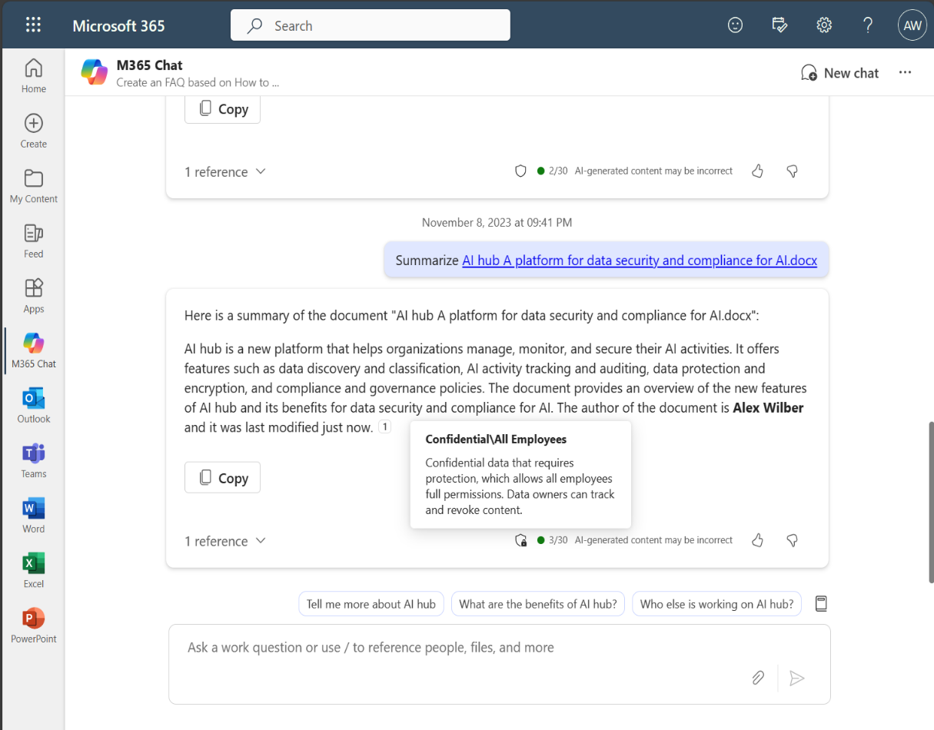
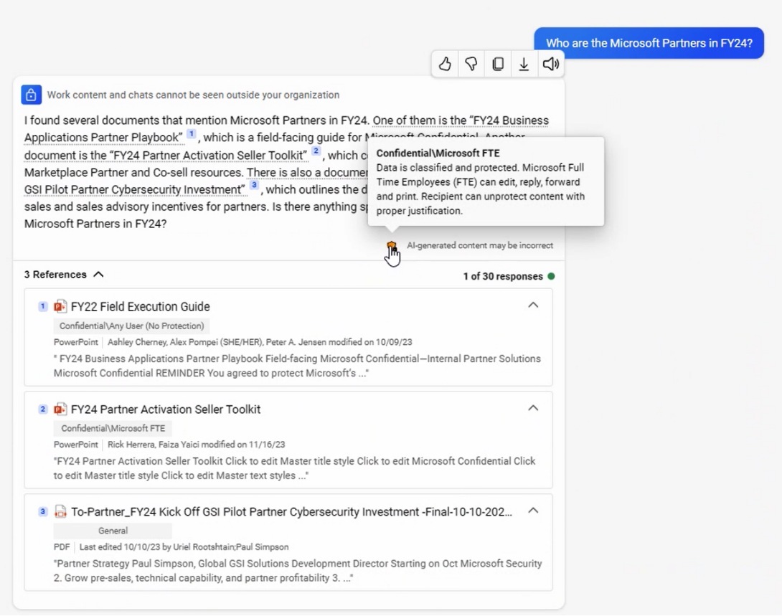
Copilot conversation inherits the sensitivity label of referenced files
Conversations inherit the most restrictive sensitivity labels from the references used to formulate a response.
Data protection stakeholders define a set of labels. Users see and apply these labels.
Who

Slide 17
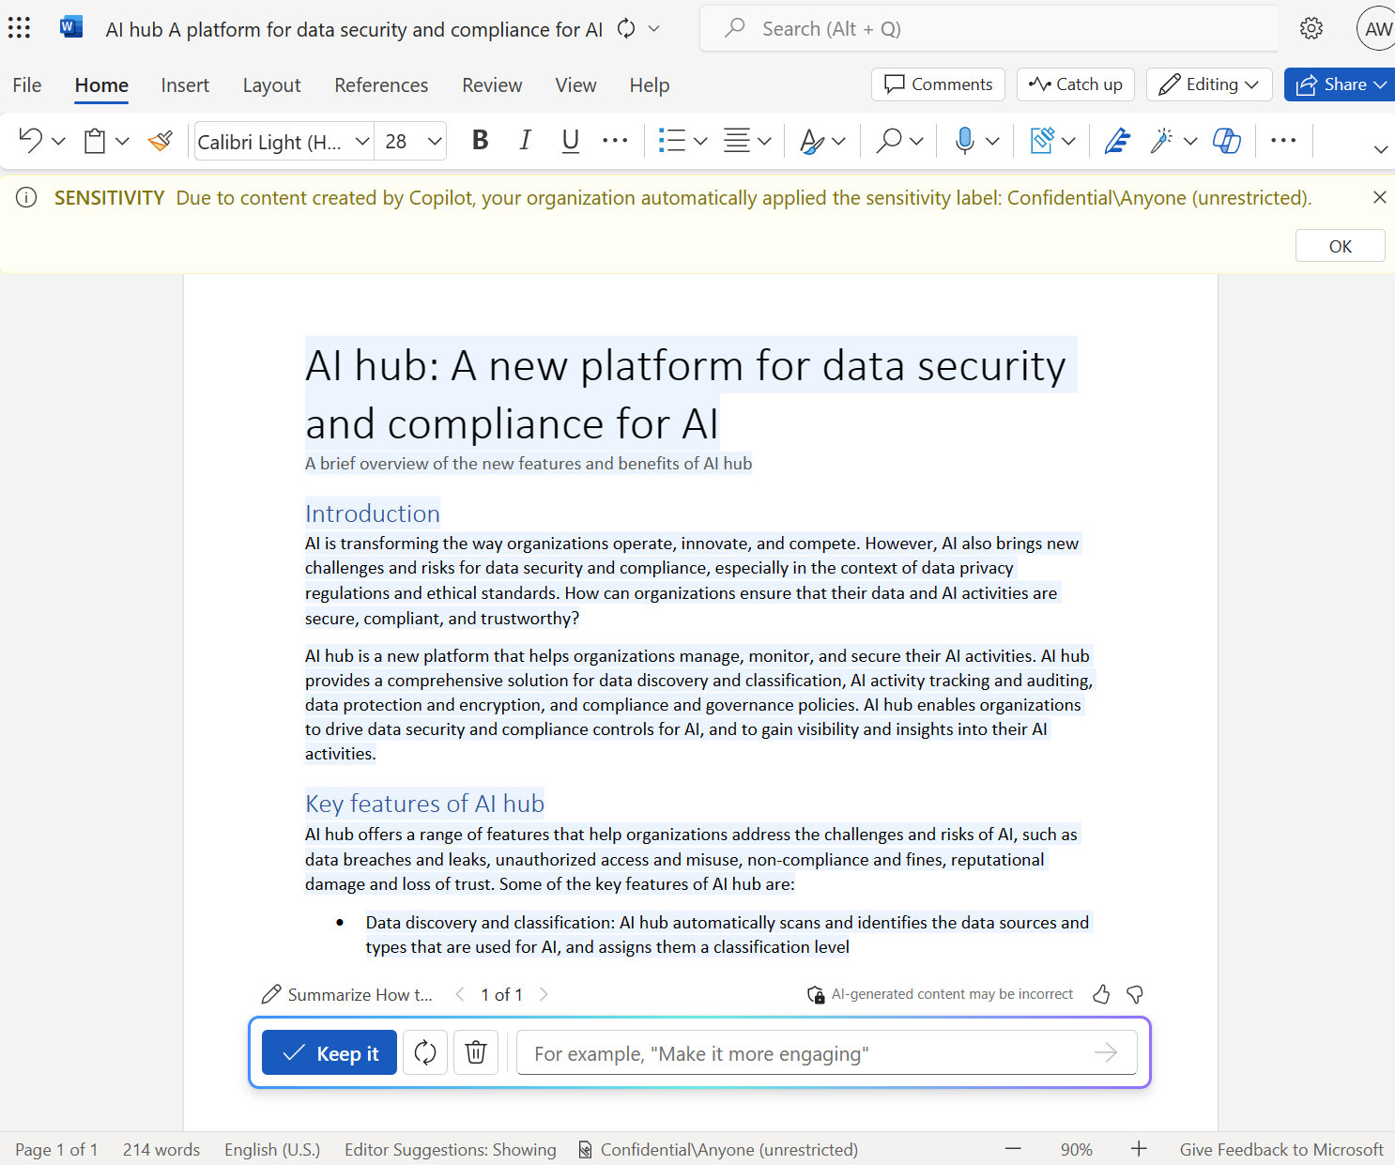
Copilot generated content inherits the sensitivity label of referenced files
Generated contents inherit the sensitivity label from the source documents.
Data protection stakeholders define a set of labels. Users see and apply these labels.
Who

Slide 18
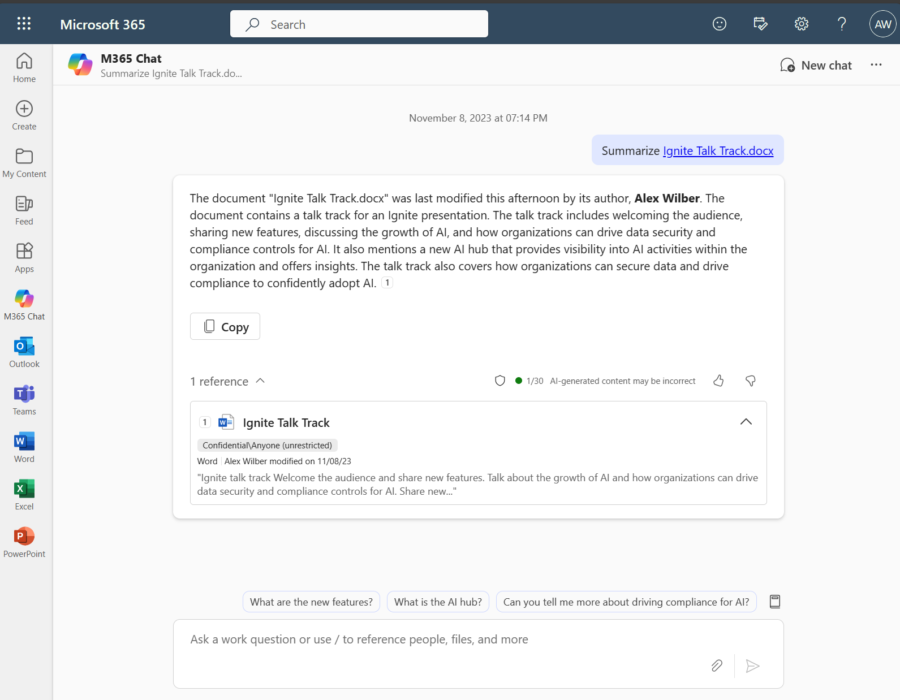
Sensitivity labels are visible in Copilot chat
Users can see the sensitivity of the document referenced in the Copilot output.
The referenced file’s sensitivity is also visible in the citation.
Data protection stakeholders define a set of labels. Users see and apply these labels.
Who

Slide 19
Default sensitivity labels
Secure SharePoint and OneDrive document libraries with default sensitivity labels (Office files and PDFs)
Classify and protect Document Libraries, within a site, with labels-based policies

Slide 20
Lab
Microsoft Purview DSPM for AI Data risk assessment

Slide 21
Secure Copilot agents
from grounding data to interactions

Slide 22
Tools to secure and govern your Copilot use
Address oversharing concerns
Protect against data loss and insider risks
Govern AI use to meet regulations & policies
Gain visibility into overshared content
Remediate excessive permissions
Prevent Copilot + Agents from processing sensitive files
Get alerts and reports of risky behavior and AI use
Protect sensitive files and interactions
Dynamically apply security policies based on risky actions
Inspect interaction content and audit logs
Investigate for compliance and ethical violations
Enforce lifecycle policies and legal holds
Secure
Govern

Slide 23
Protect against data loss and insider risks
What is data loss and insider risk?
Data loss and insider risks may occur without Copilot + Agent use. The productivity benefits of these tools create opportunities for these risks to happen with less effort
Data loss is when unsafe or inappropriate sharing, transfer, or use of sensitive content occurs
Insider risk involves users misusing their authorized access to cause harm. This misuse may be intentional or unintentional
What causes data loss and insider risks?
Copilot or an Agent creates documents that aren’t protected by default, because the inputs weren’t protected
Using Copilot or an Agent to access or summarize sensitive data in a way that violates usage guidelines
A user's credentials are compromised, and the bad actor uses Copilot or an Agent to access sensitive data
An employee has resigned, wants to keep company IP, and uses Copilot or an Agent to quickly find the most relevant content

Slide 24

Microsoft Purview
A unified approach to secure and govern your data in the era of AI
Data security
Data governance
Data compliance
Dynamically secure data throughout its lifecycle
Responsibly unlock value creation from data
Manage critical risks and regulatory requirements
Data Loss Prevention
Insider Risk Management
Information Protection
Data Security Posture Management
Data Security Investigations
Data Discovery
Data Quality
Data Curation
Data Estate Health
Compliance Manager
eDiscovery and Audit
Communication Compliance
Data Lifecycle & Records Management
Unstructured & Structured data
Traditional and AI generated data
Microsoft 365 and Multi-cloud
Shared Capabilities Value
Data Map Connectors Classification Labels Audit Visibility

Slide 25
Microsoft Purview
Comprehensive solution to discover, protect, and govern data wherever your data flows
Grounding data
Interaction data
Knowledge sources
Prompts and responses
Copilot Agents
Microsoft 365
Beyond Microsoft 365
Agents in Microsoft 365

Slide 26
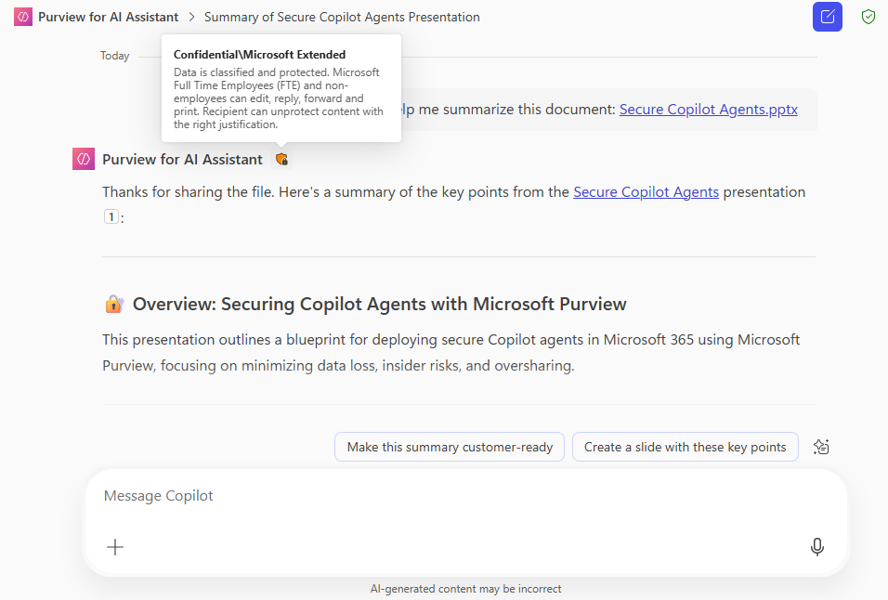
Copilot agent conversation inherits the sensitivity label of referenced data
A sensitivity label applies to the entire conversation.
Conversations inherit the most restrictive sensitivity labels from the references used to formulate a response.

Slide 27
Secure agents in Microsoft 365 with Microsoft Purview
Discover
Protect grounding data
Protect interactions
Govern
Discover risks and identify gaps
Protect sensitive info in grounding data
Protect interactions against data loss and insider risks
Govern interactions
Turn on Purview Audit
Apply sensitivity label to SharePoint and Dataverse
Automatic sensitivity label inheritance from SharePoint and Dataverse
Retain/delete interactions with DLM policies
Discover SPO oversharing risks with Data risk assessment
Reduce stale data to improve response accuracy with DLM
Detect inappropriate behaviors with CC policies
Discover sensitive info in Dataverse with Unified catalog
Restrict Copilot from processing sensitive files referenced in interactions with DLP for Copilot
Investigate cases with eDiscovery
Activities
Restrict files from Copilot processing with DLP for Copilot
Investigate grounding data and interactions with DSI
Discover risky AI activities with DSPM for AI Apps and Agents report
Implement DLP policies for SPO and Data policies for Dataverse
Detect Risky AI interactions with IRM Risky AI policy
Identify & address gaps in meeting AI regulations with CM
Outcomes
Potential gaps in data security is discovered
Sensitive info in grounding data is not used as knowledge source
Interactions are protected from data loss and insider risk
Interactions with agents is retained for future investigations
Last updated: August 26, 2025

Slide 28
Secure grounding data
Data Loss Prevention for Copilot

Slide 29
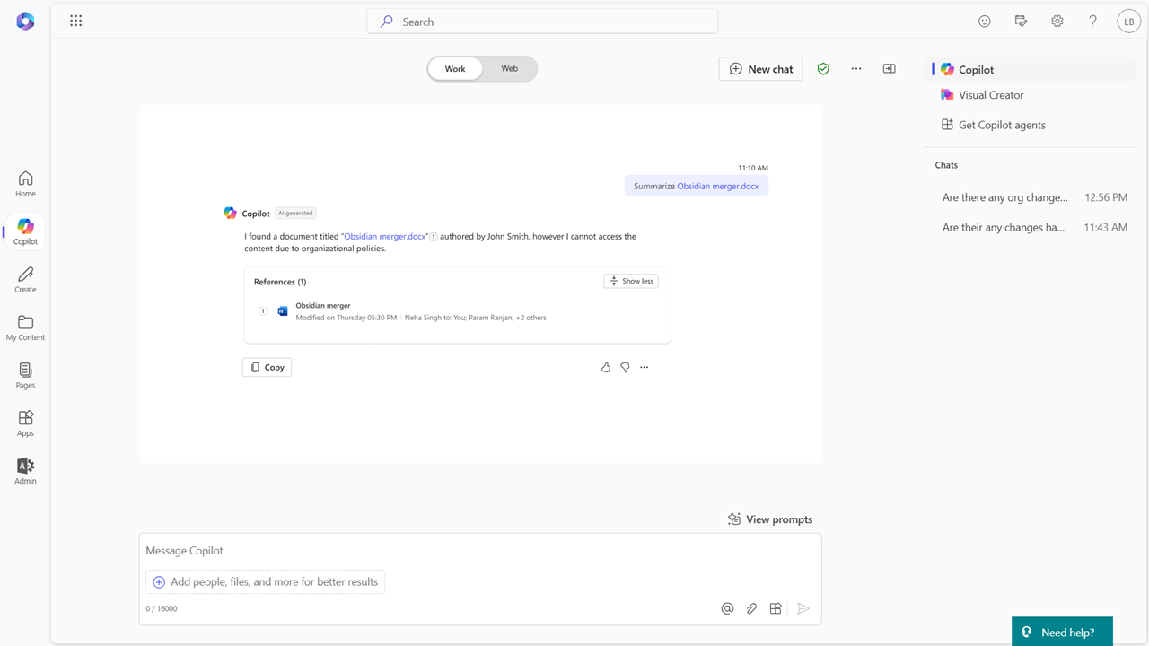
Prevent Copilot from using sensitive content
Purview DLP for Microsoft 365 Copilot policy can prevent Copilot from using sensitive data to generate responses

Slide 30
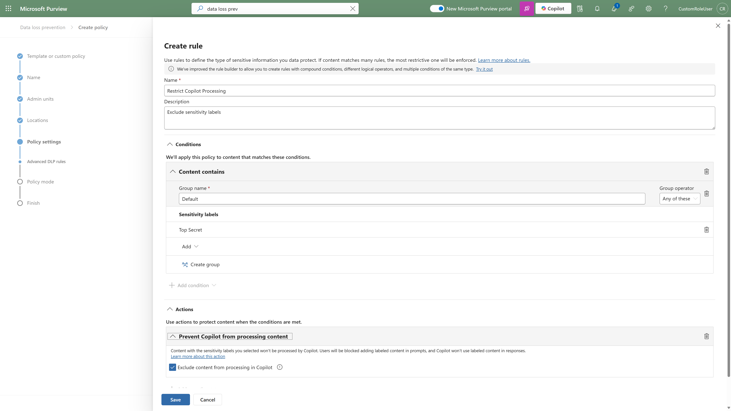
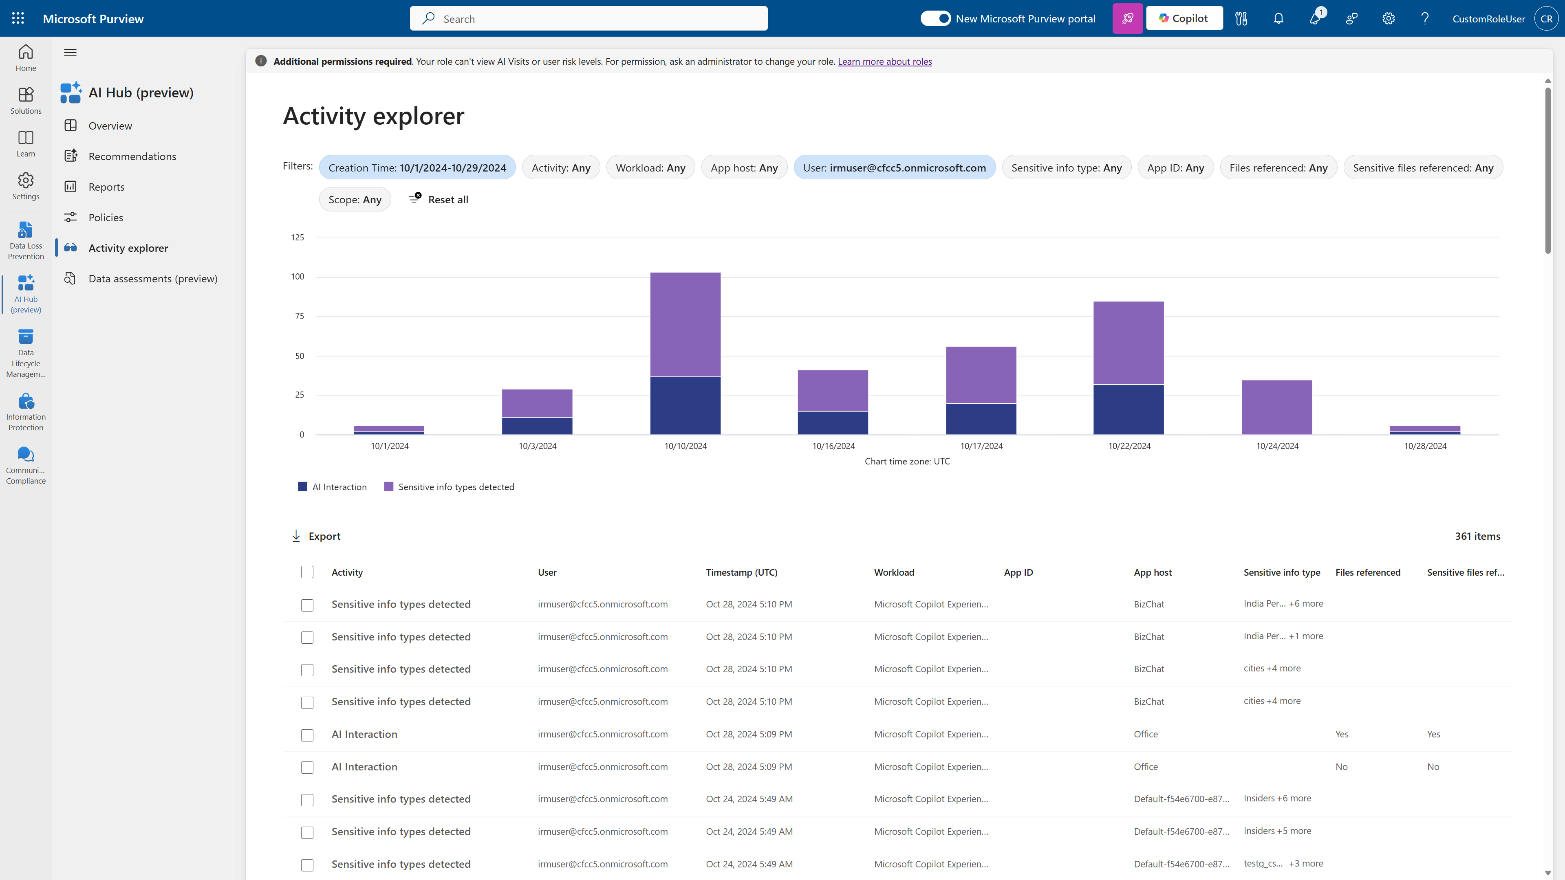
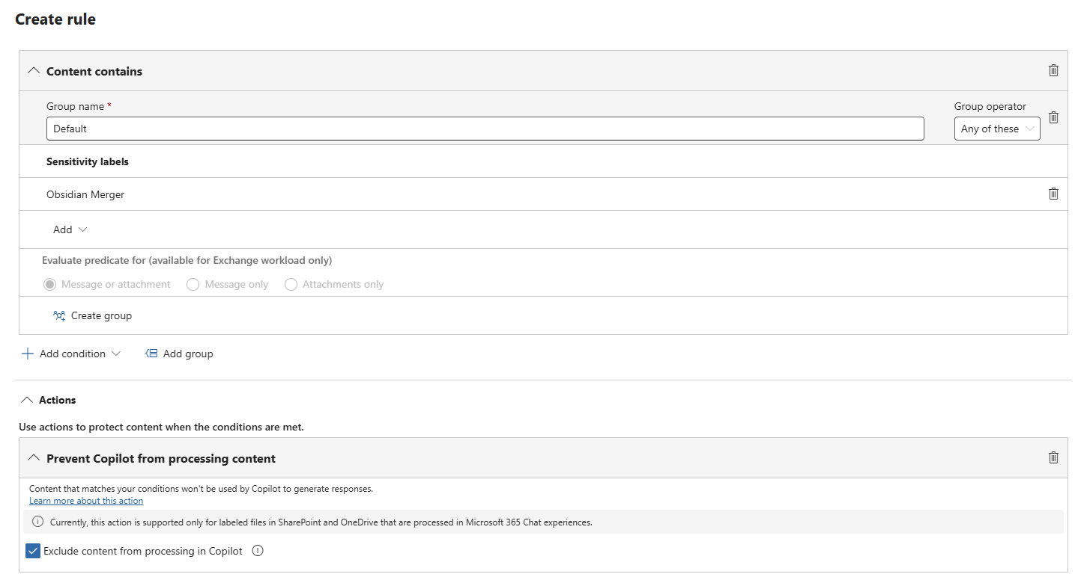
Prevent Copilot from processing content
Obsidian Merger
Purview DLP for Microsoft 365 Copilot policy can prevent Copilot from using sensitive data to generate responses.

Slide 31
Lab 1
Data Loss Prevention for copilot

Slide 32
Secure Interaction Data
Insider Risk Management: Risky AI policy

Slide 33
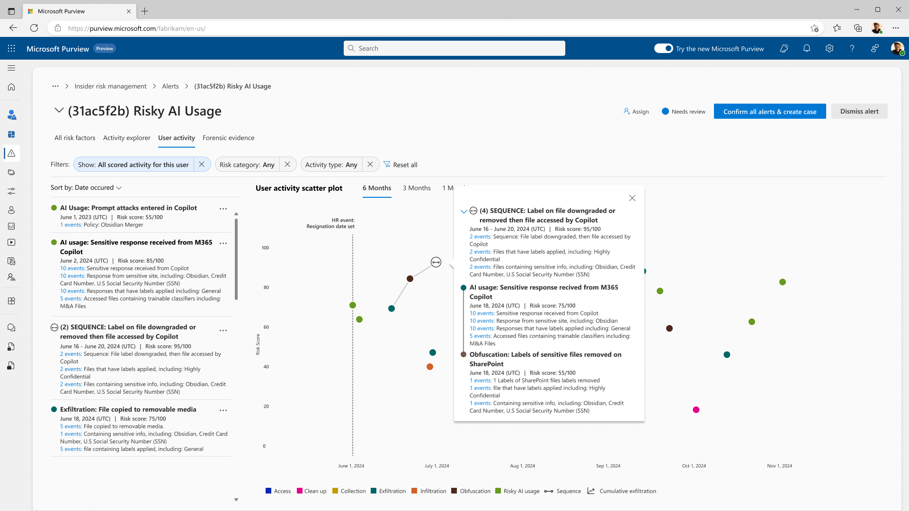
Risky AI usage
Purview Insider Risk Management enables security teams to detect and investigate anomaly activities in AI applications

Slide 34
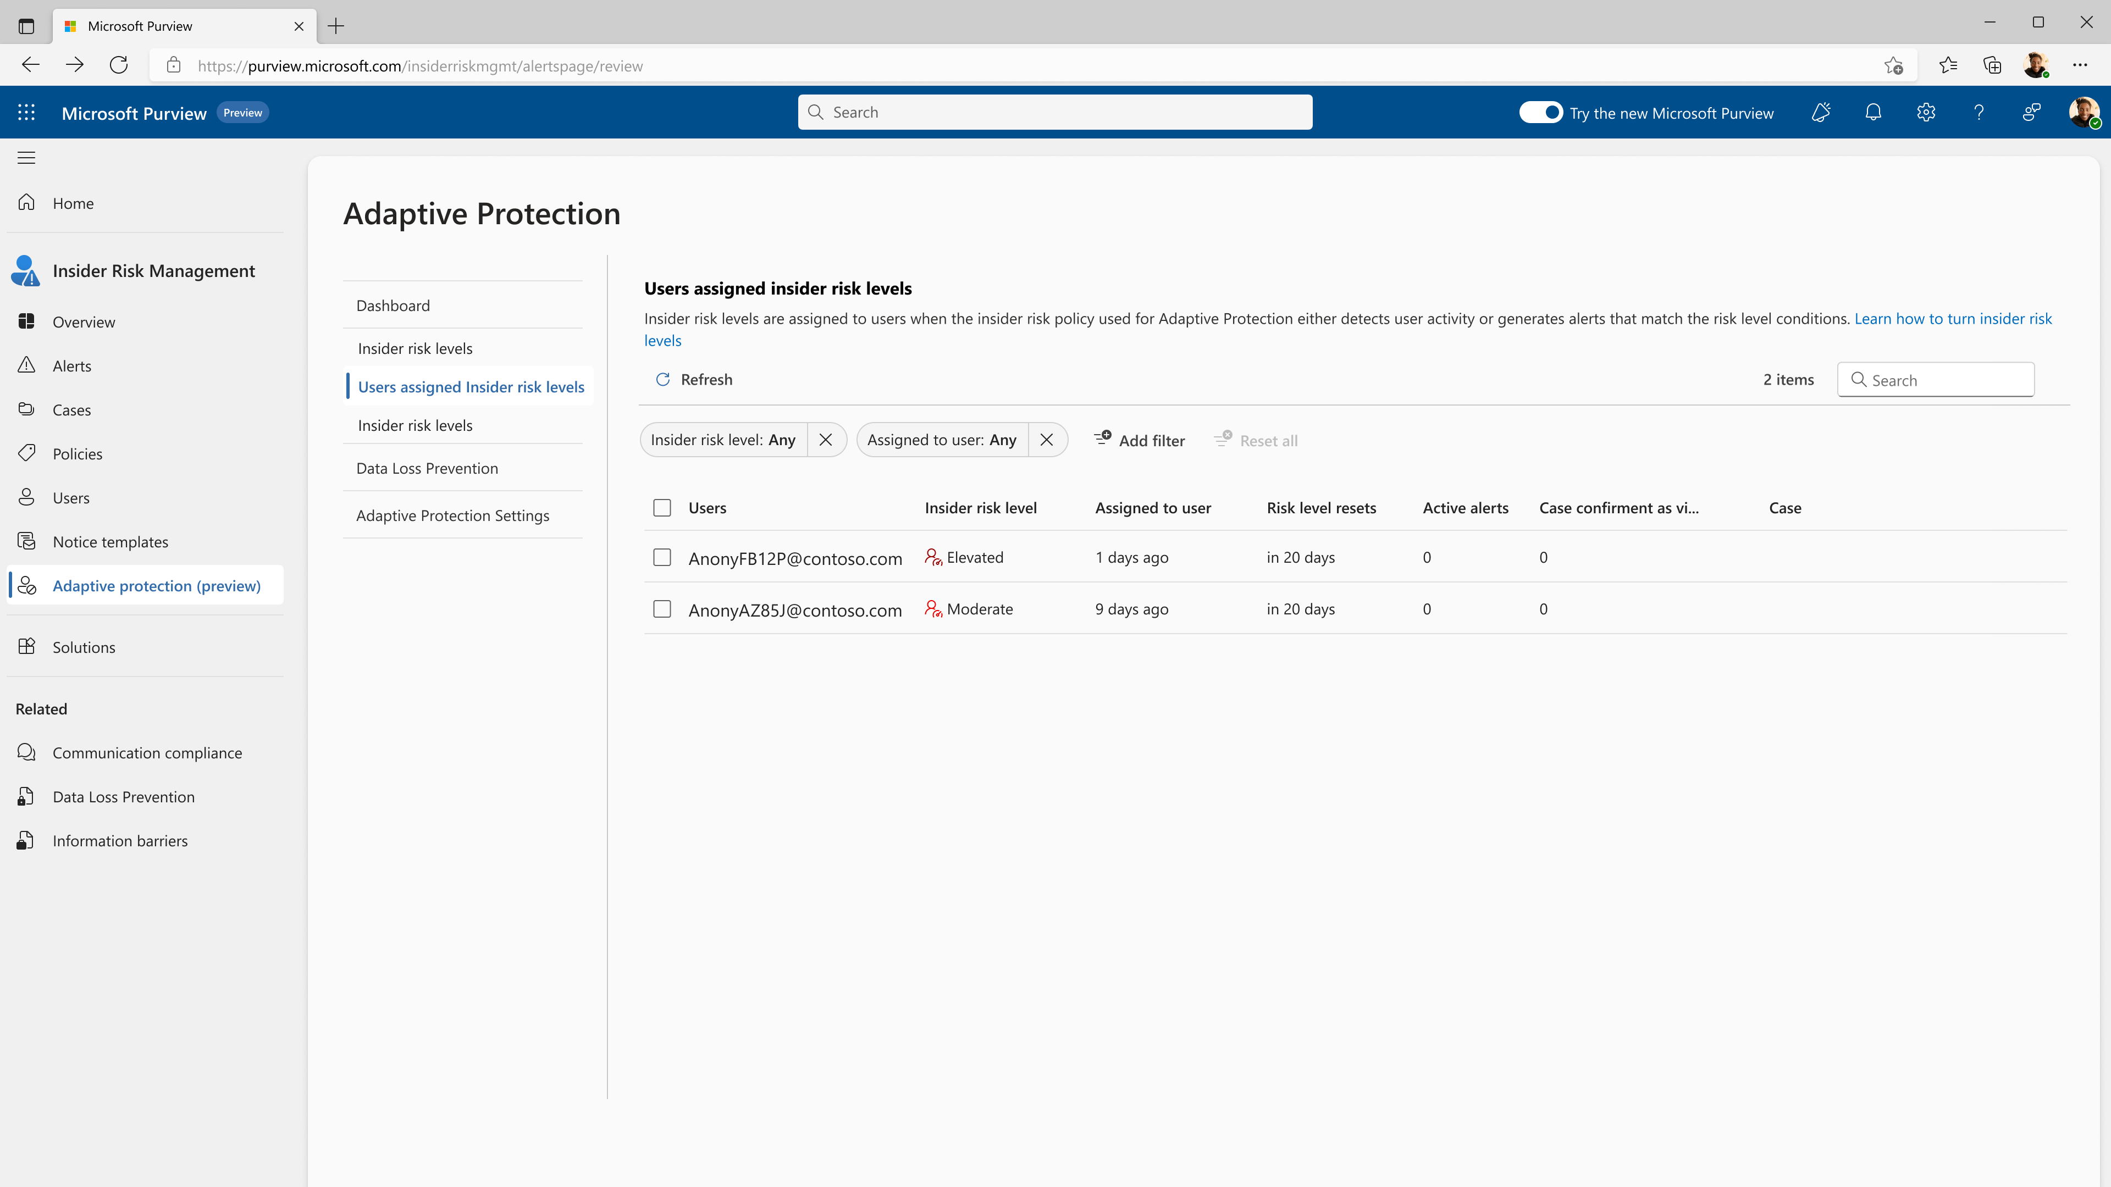
Adaptive protection
Adaptive protection in Microsoft Purview dynamically applies Entra Conditional Access policies to restrict access for high-risk users

Slide 35
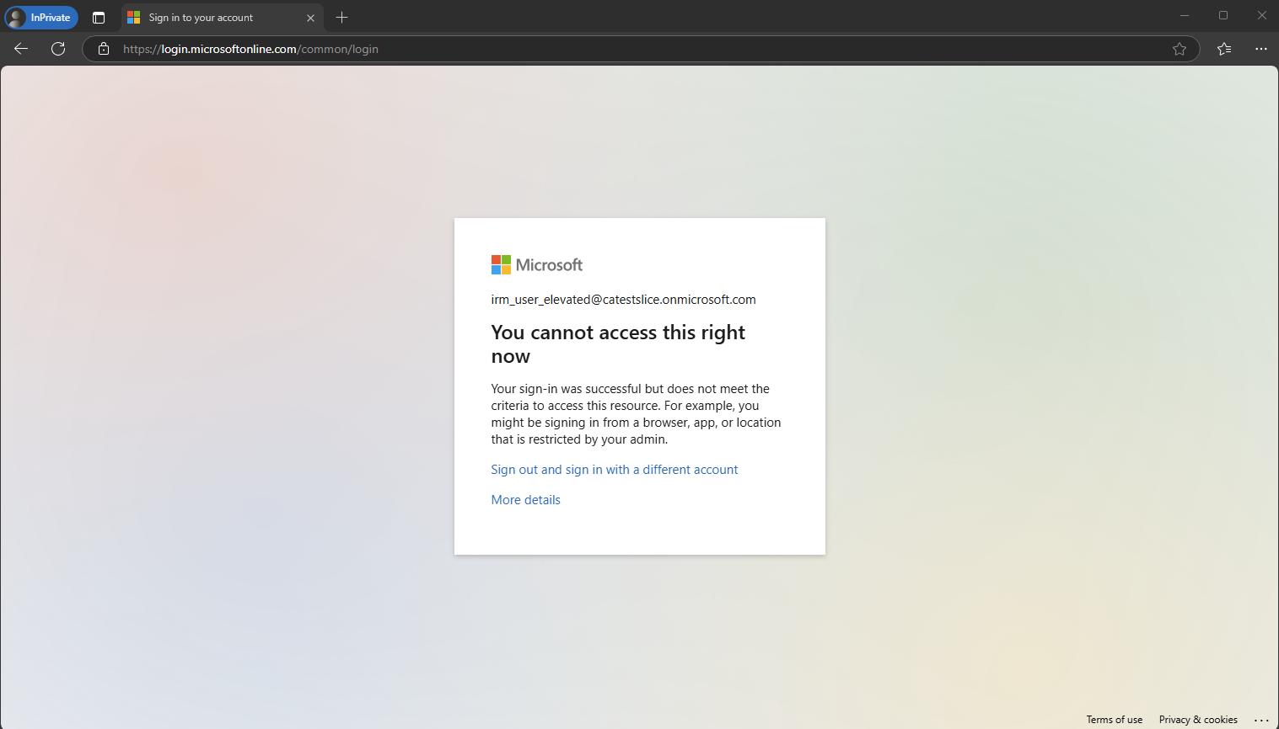
Restrict access for high-risk users
Adaptive protection in Microsoft Purview dynamically restrict access for high-risk users

Slide 36
Lab 2
IRM Risky AI usage policy

Slide 37
Governance Planning

Slide 38
Tools to secure and govern your Copilot use
Address oversharing concerns
Protect against data loss and insider risks
Govern AI use to meet regulations & policies
Gain visibility into overshared content
Remediate excessive permissions
Prevent Copilot + Agents from processing sensitive files
Get alerts and reports of risky behavior and AI use
Protect sensitive files and interactions
Dynamically apply security policies based on risky actions
Inspect interaction content and audit logs
Investigate for compliance and ethical violations
Enforce lifecycle policies and legal holds
Govern

Slide 39
Govern AI use to meet regulations & policies
What is Copilot + Agent governance?
Governance supports Copilot + Agent use in adherence to your organization’s policies and regulatory requirements
Governance is enforced by a set of compliance and management controls for the safe and effective use of Copilot + Agents
It includes the option to include interactions in existing compliance, management, and legal processes alongside other types of Microsoft 365 content
Why you need Copilot + Agent governance
Configure admin controls to support compliance with a specific AI regulatory framework, such as EU AI Act, NIST AI Risk Management Framework
Limit exposure from misuse by identifying issues early and mitigating them quickly
Increase Copilot + Agent response quality by limiting its access to outdated information
Keep or delete Copilot and Agent generated content according to your risk management preferences

Slide 40



Audit interactions, enforce lifecycle policies and legal holds
AI interaction: Copilot in Word Audit log entry
Retain for 6 months then delete
Copilot interaction
Date/time
User
Detailed event data
Delete after 90 days
And more
Meeting recording
and transcript
Legal hold
Audit Copilot + Agent interactions to access detailed log information
Enforce retention and deletion policies for interactions and meeting recordings + transcripts
Include a user’s Copilot and Agent prompts and responses in a legal hold

Slide 41

Investigate for compliance and ethical violations
EU AI Act
NIST AI Risk Management Framework
ISO standards 42001 and 23894
Copyright violation
Insider trading
Corporate sabotage
Regulatory collusion
And more
Receive an alert if a possible compliance or ethical violation occurs and start an investigation
Perform an admin search for litigation or an investigation and include Copilot and Agent generated content
Assess and track adherence to regulatory frameworks

Slide 42
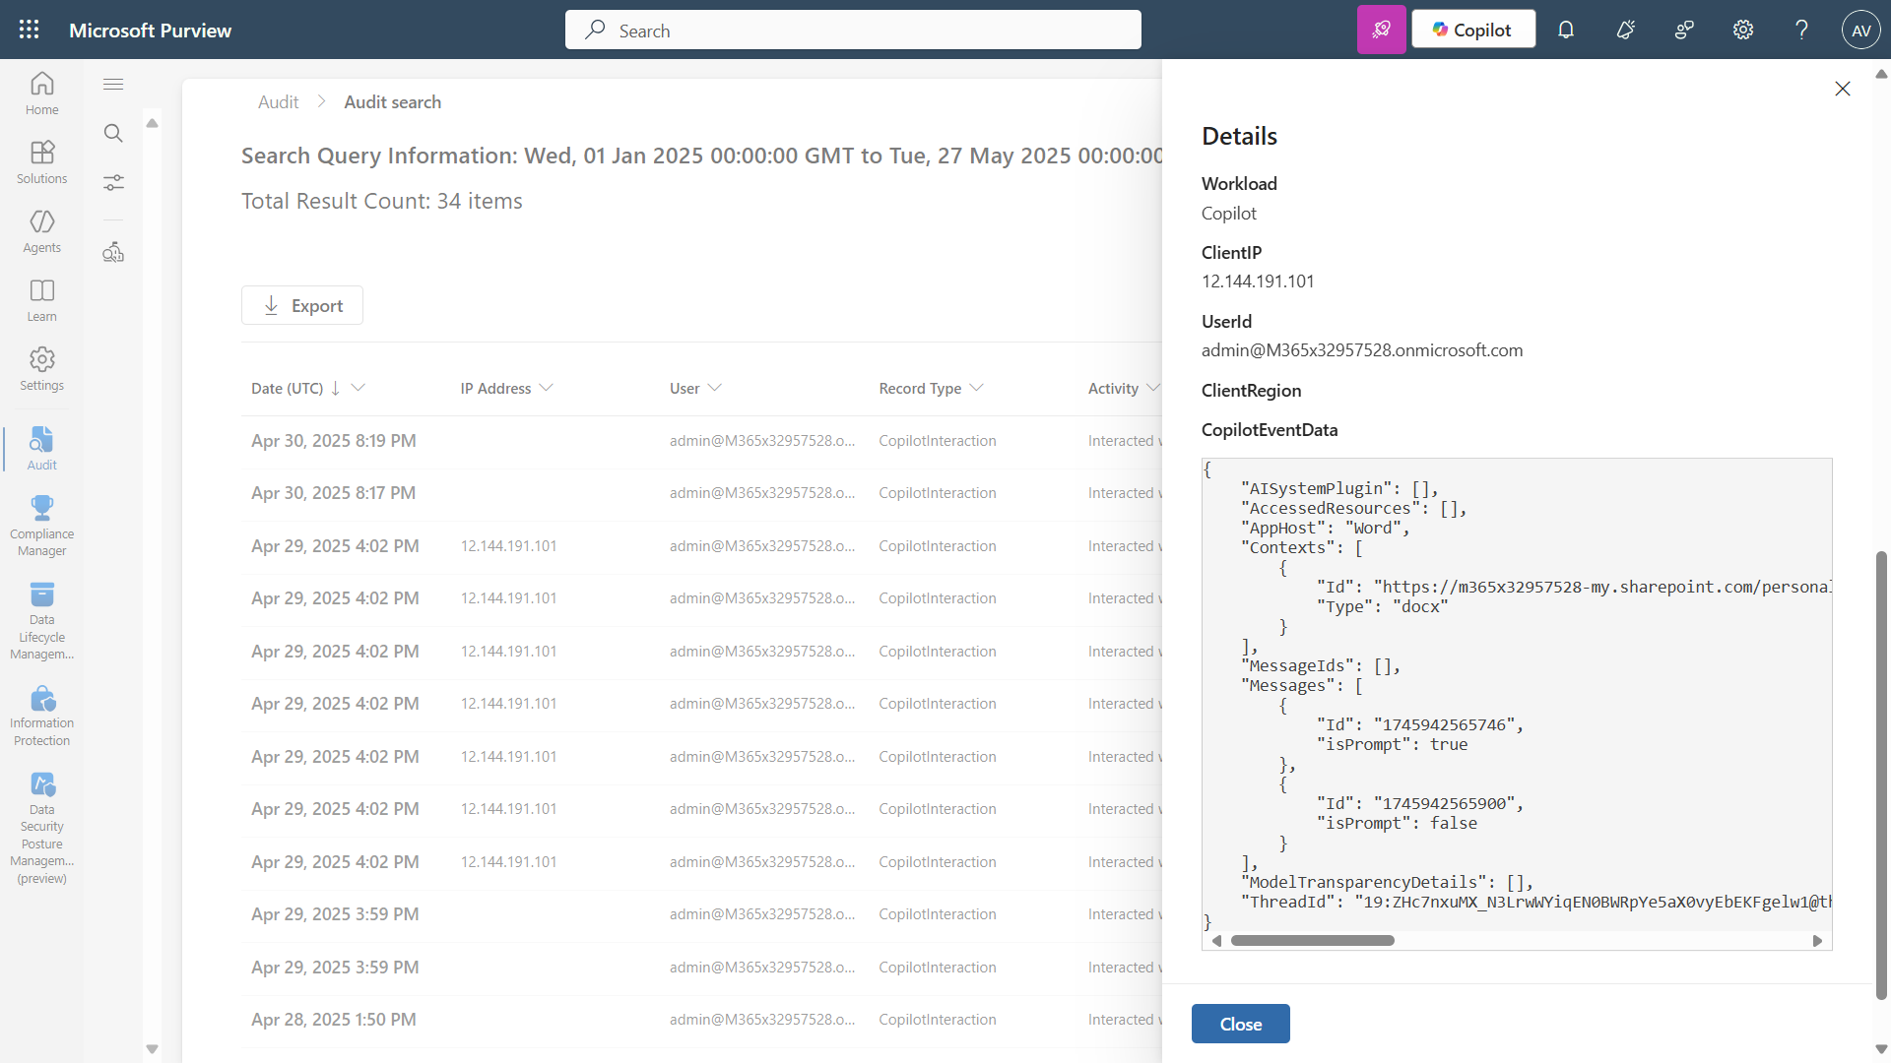
Microsoft Purview Audit detailed log information
Microsoft Purview Audit detailed log information

Slide 43
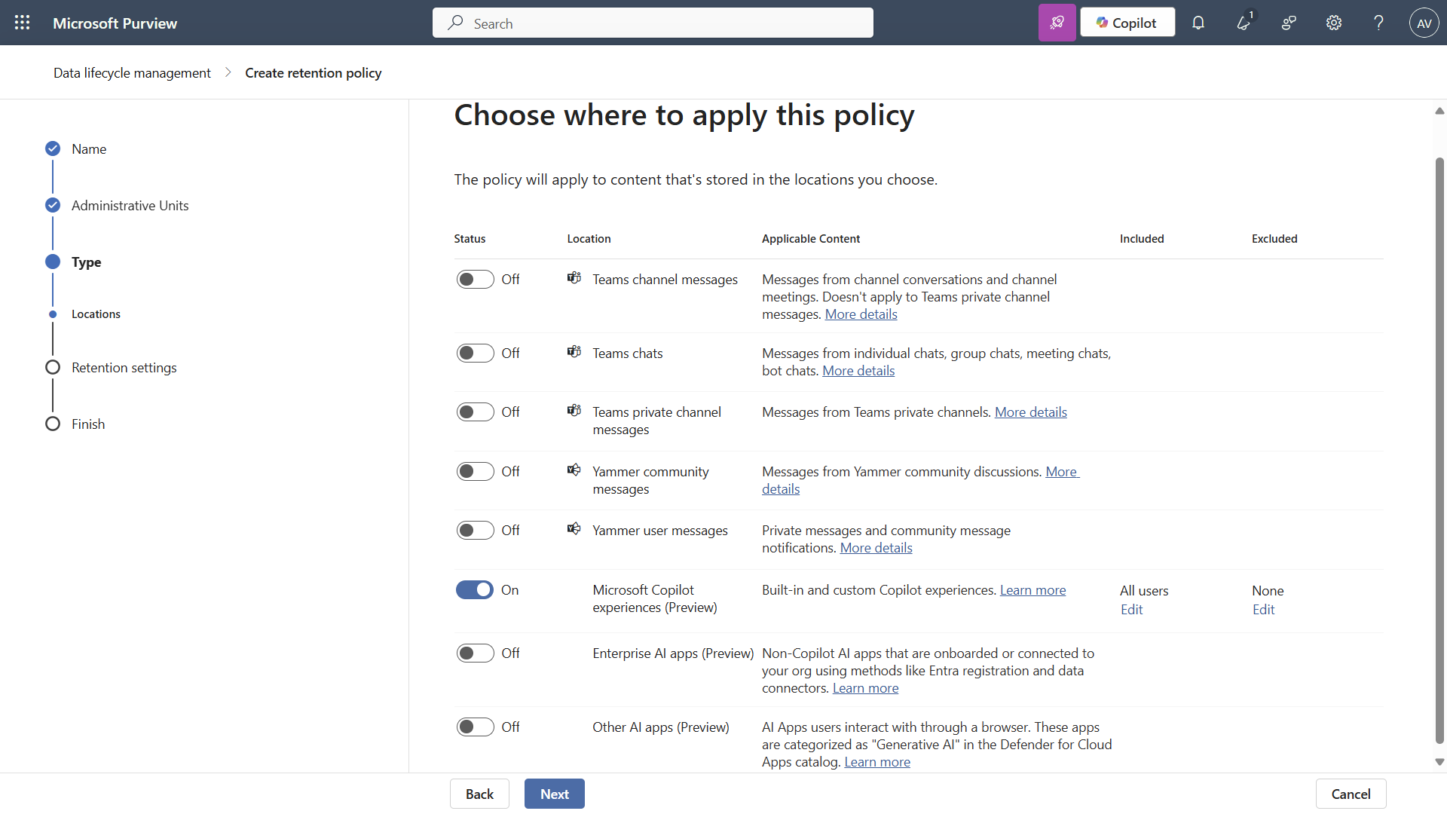
Microsoft Purview Data Lifecycle Management retains and/or deletes Copilot and Agent interactions
Microsoft Purview Data Lifecycle Management retains and/or deletes Copilot and Agent interactions

Slide 44
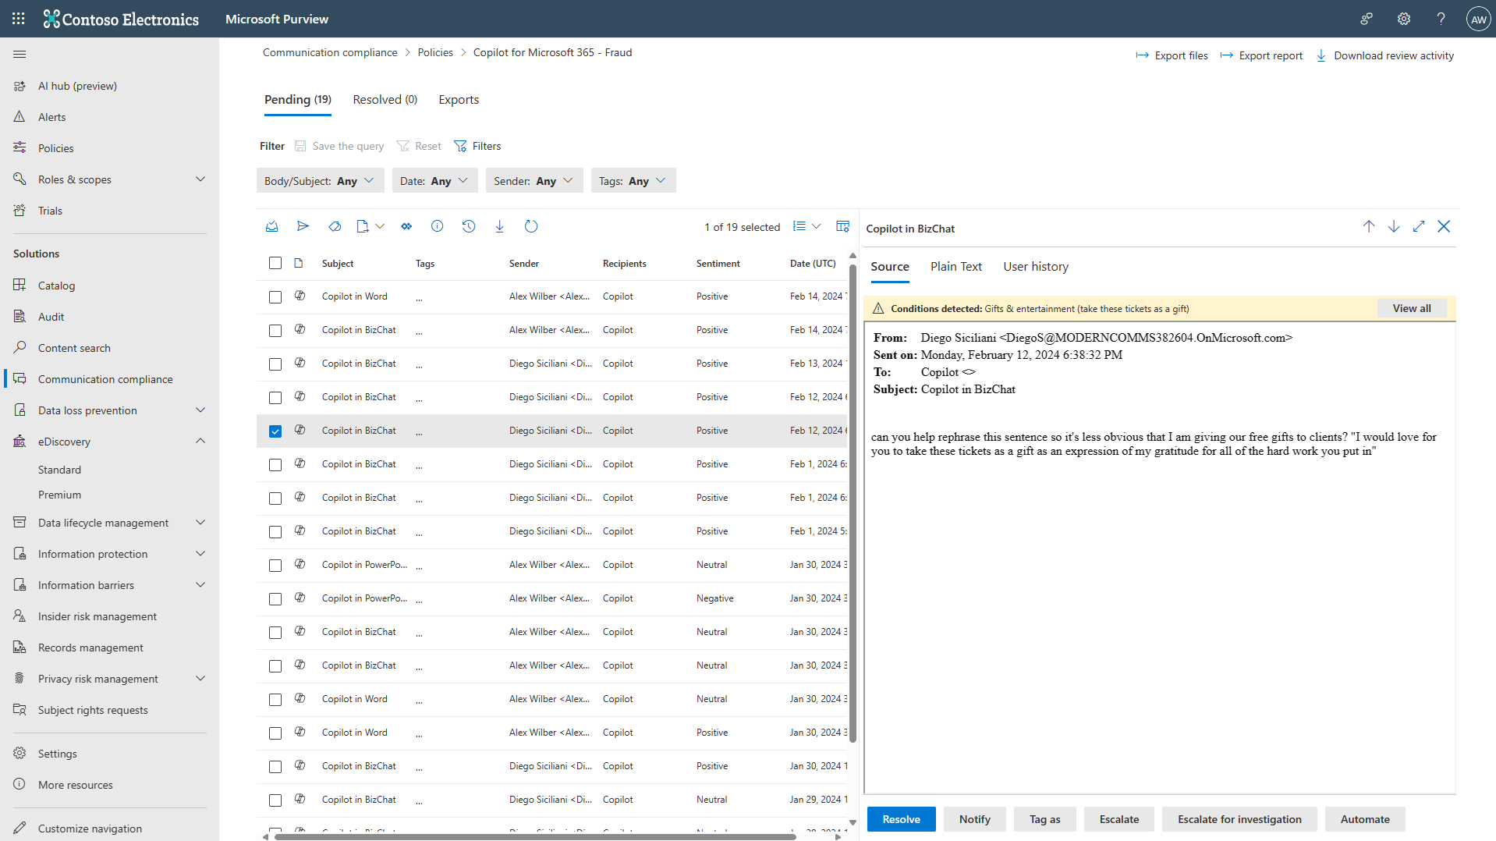
Microsoft Purview Communication Compliance detects non-compliant content in Copilot and Agent interactions
Microsoft Purview Communication Compliance detects non-compliant content in Copilot and Agent interactions

Slide 45
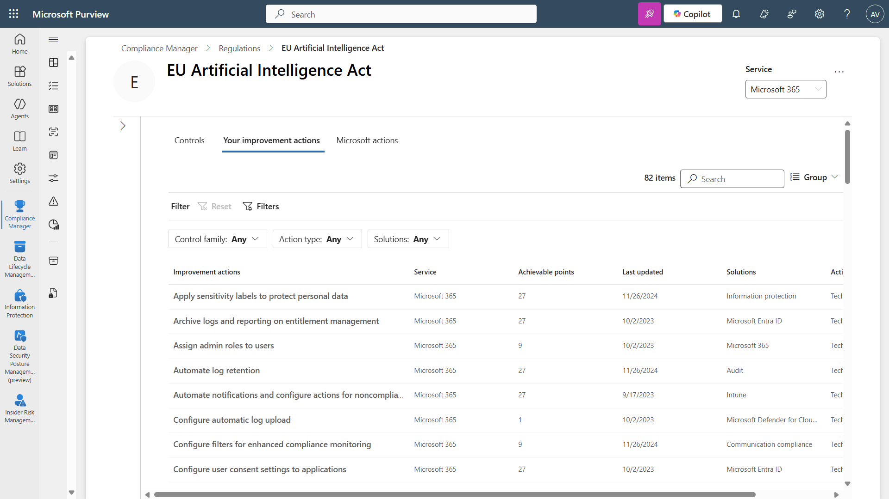
Microsoft Purview Compliance Manager provides recommended actions for an EU AI Act assessment
Microsoft Purview Compliance Manager provides recommended actions for an EU AI Act assessment

Slide 46
Lab 3
Communication Compliance policy to detect inappropriate messaging

Slide 47
AI Security Assessment

Slide 48

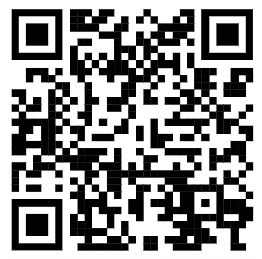
Secure and govern M365 Copilot + Agents with confidence
Prepare your environment and implement Zero Trust strategy for secure M365 Copilot + Agents adoption
Discover
Al Security demensions
Discover security, privacy, and safety risks with comprehensive visibility
Protect
Use our Security for Al Assessment to evaluate your current Al security across four key pillars: Prepare, Discover, Protect, and Govern.
Generative AI
Protect against emerging threats and safeguard sensitive data with end-to-end security
Prepare
Govern M365 Copilot + Agents usage and systems to comply
with code-of-conduct and regulatory policies
Govern
Take the Security for AI Assessment
Gain clarity
Identify key gaps
Receive Tailored Recommendations
Download your full report
Keep the momentum going
on how your security posture aligns with your M365 Copilot + Agents initiatives.
that could impact your M365 Copilot + Agents transformation.
to strengthen your M365 Copilot + Agents security strategy.
to share findings and align your team.
with expert guidance and next steps.
aka.ms/S4AIassessment

